Slide 1
Basics of Machine Learning with Python
A 2 day hands on workshop by Evam Kaushik

Slide 2
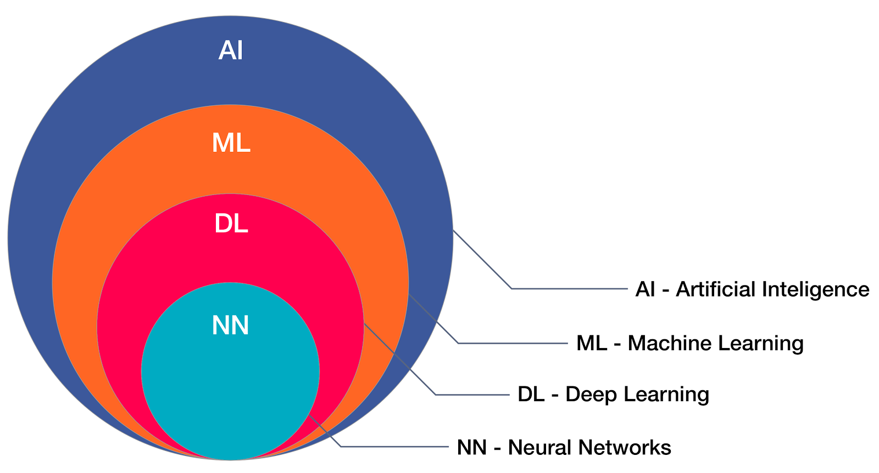
What is Machine Learning
Machine learning is an application of artificial intelligence (AI) that provides systems the ability to automatically learn and improve from experience without being explicitly programmed. Machine learning focuses on the development of computer programs that can access data and use it learn for themselves.
Some of the most common applications are
Auto tagging images of people on facebook
Speech recognition (Ok Google, Hey Siri, Alexa, Ni Hau Baidu)
Medical Diagnosis
Stock Price Predictor

Slide 3
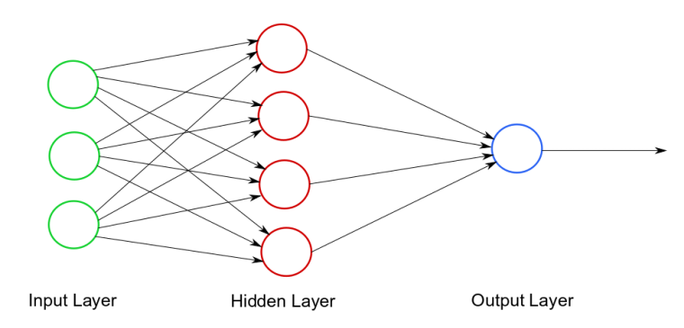
What are Neural Networks?
Artificial neural networks (ANN) are computing systems vaguely inspired by the biological neural networks that constitute animal brains. Such systems "learn" to perform tasks by considering examples, generally without being programmed with task-specific rules. For example, in image recognition, they might learn to identify images that contain cats by analyzing example images that have been manually labeled as "cat" or "no cat" and using the results to identify cats in other images. They do this without any prior knowledge of cats, for example, that they have fur, tails, whiskers and cat-like faces. Instead, they automatically generate identifying characteristics from the examples that they process.

Slide 4
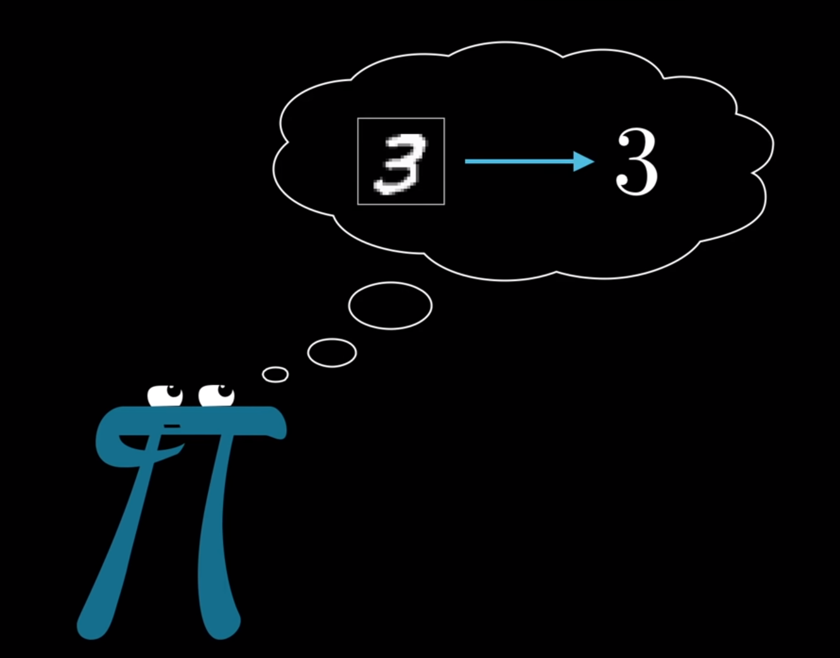
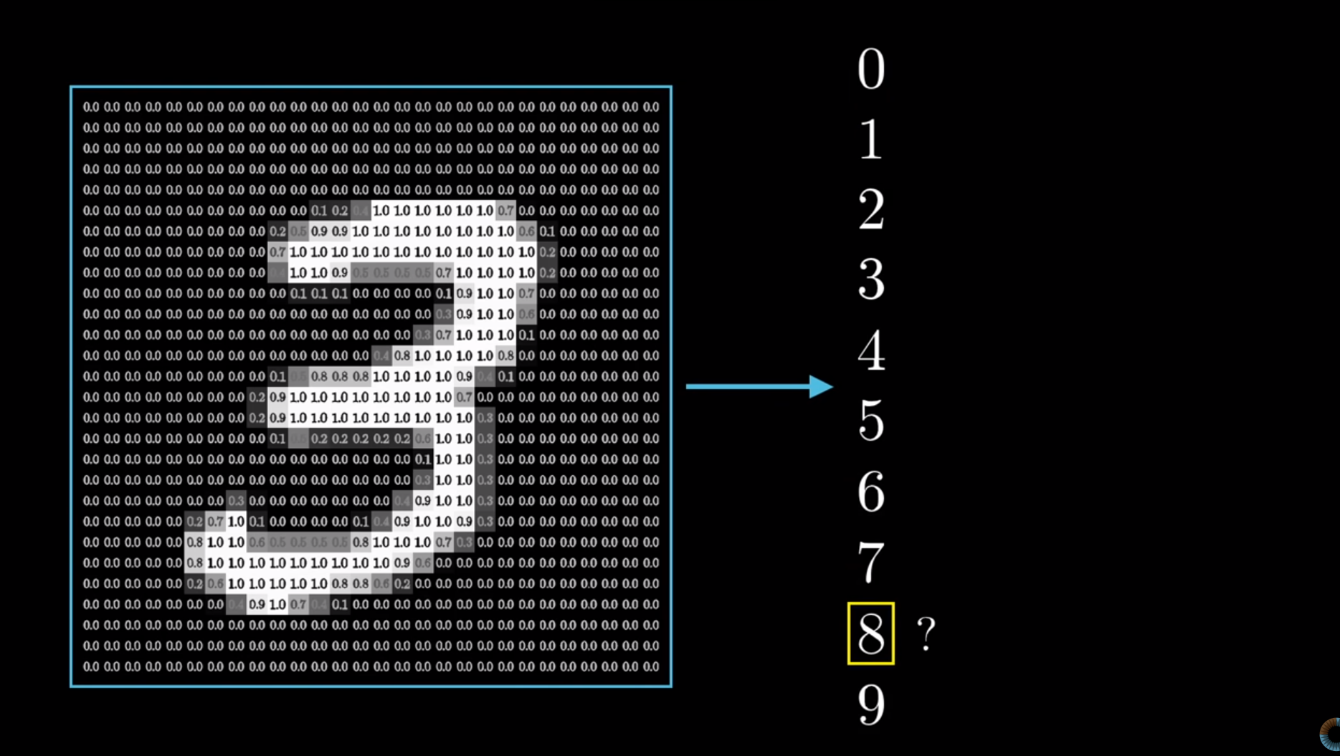
How Neural Networks work
Let’s take the example of handwritten digit recognition software here.
It takes as input an image of a hand written digit and returns a probability of what the digit is between 0-9.
Credits : 3Blue1Brown on YouTube

